Slide 1
Tutorial 7: NUMBER THEORY 2
CS1231S T03A
Adapted from slides by Lin Geyu & Zhu Xiaochen, with additions by Aaron Tan and Theodore L

Slide 2
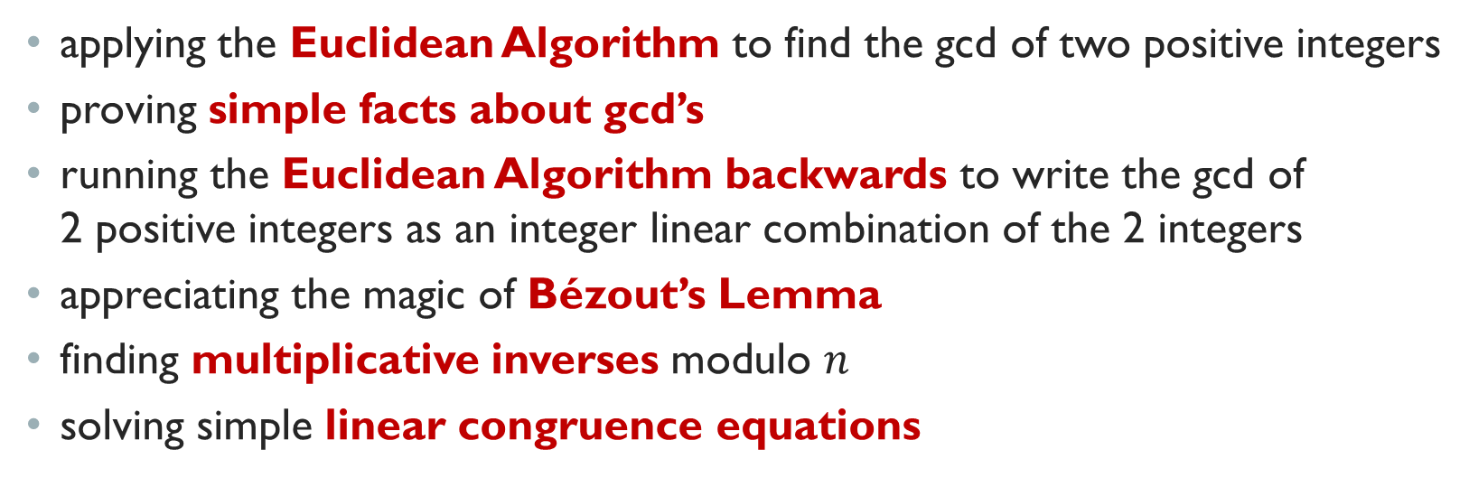
Learning objectives of this tutorial
applying the Euclidean Algorithm to find the gcd of two positive integers
proving simple facts about gcd’s
running the Euclidean Algorithm backwards to write the gcd of 2 positive integers as an integer linear combination of the 2 integers
appreciating the magic of Bézout’s Lemma
finding multiplicative inverses modulo $n$
solving simple linear congruence equations

Slide 3
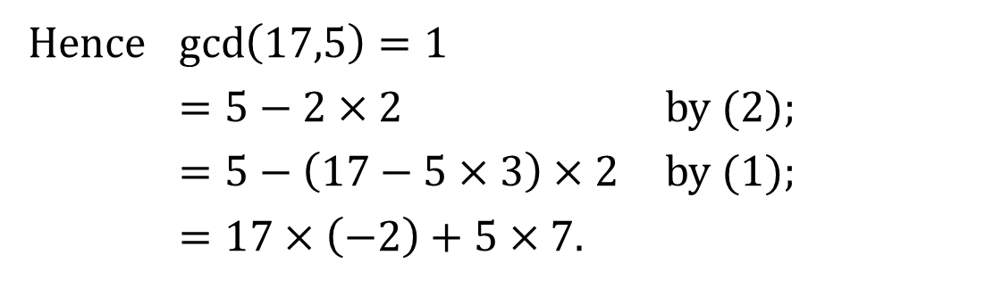
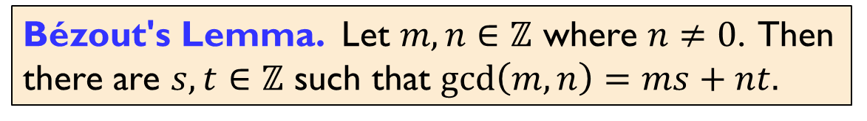
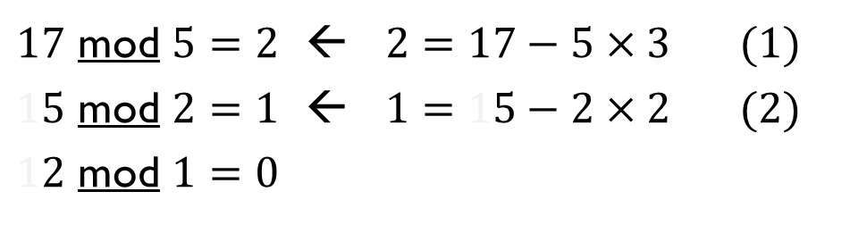
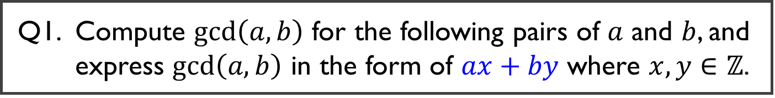
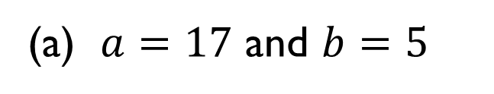
Q1. Compute $\gcd\left(a,b\right)$ for the following pairs of $a$ and $b$, and express $\gcd\left(a,b\right)$ in the form of $ax+by$ where $x,y∈ℤ$.
(a) $a=17$ and $b=5$
$17$ mod $5=2$ ← $2=17−5×3$ (1)
$15$ mod $2=1$ ← $1=15−2×2$ (2)
$12$ mod $1=0$
Hence $\gcd\left(17,5\right)=1$
$=5−2×2$ by (2);
$=5−\left(17−5×3\right)×2$ by (1);
$=17×\left(−2\right)+5×7$.
Bézout's Lemma. Let $m,n∈ℤ$ where $n≠0$. Then there are $s,t∈ℤ$ such that $\gcd\left(m,n\right)=ms+nt.$

Slide 4
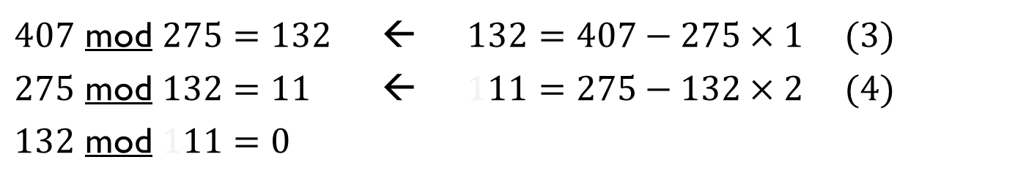
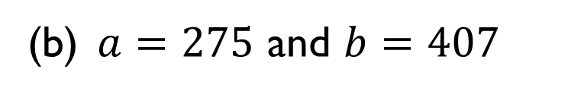
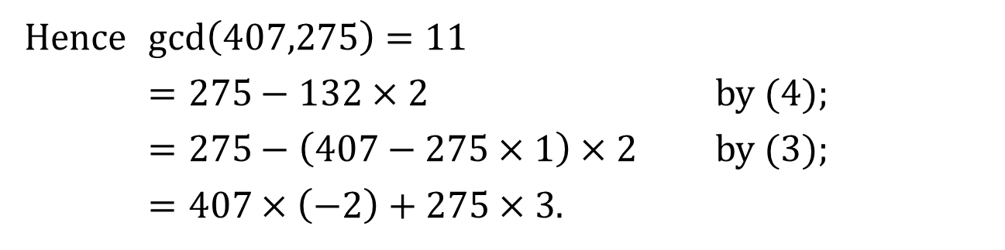
Q1. Compute $\gcd\left(a,b\right)$ for the following pairs of $a$ and $b$, and express $\gcd\left(a,b\right)$ in the form of $ax+by$ where $x,y∈ℤ$.
(b) $a=275$ and $b=407$
$407$ mod $275=132$ ← 13$2=407−275×1$ (3)
$275$ mod $132=11$ ← 11$1=275−132×2$ (4)
$132$ mod $111=0$
Hence $\gcd\left(407,275\right)=11$
$=275−132×2$ by (4);
$=275−\left(407−275×1\right)×2$ by (3);
$=407×\left(−2\right)+275×3$.
Bézout's Lemma. Let $m,n∈ℤ$ where $n≠0$. Then there are $s,t∈ℤ$ such that $\gcd\left(m,n\right)=ms+nt.$

Slide 5
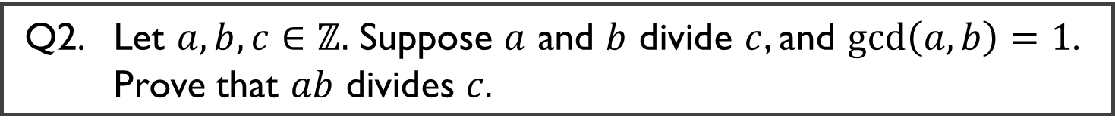
Q2. Let $a,b,c∈ℤ.$ Suppose $a$ and $b$ divide $c$, and $\gcd\left(a,b\right)=1$. Prove that $ab$ divides $c.$

Slide 6
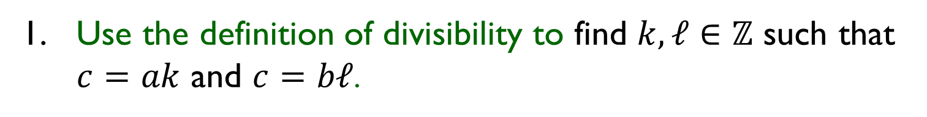
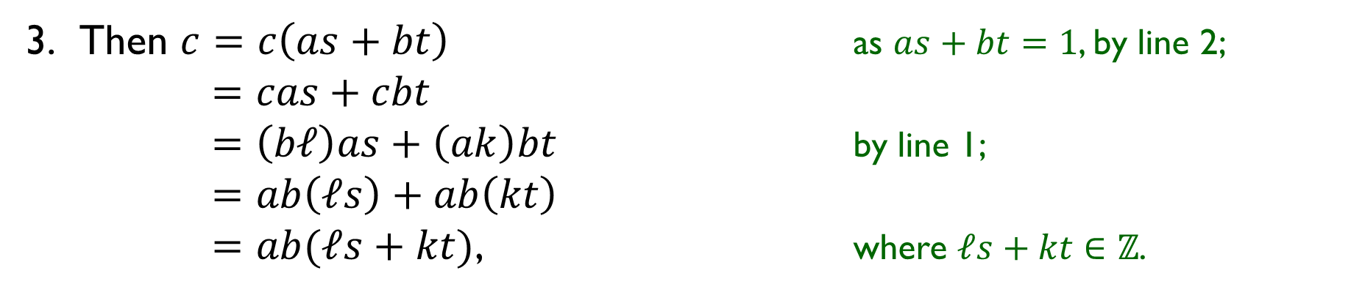
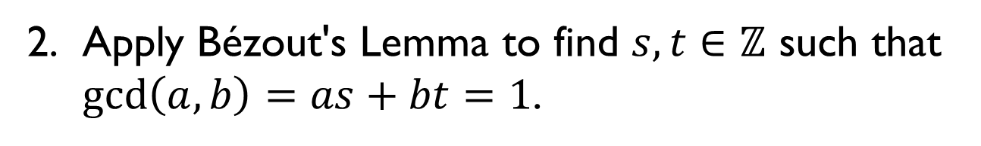
Q2. Let $a,b,c∈ℤ.$ Suppose $a$ and $b$ divide $c$, and $\gcd\left(a,b\right)=1$. Prove that $ab$ divides $c.$
0. As gcd(a, b) =1, $a ≠0$ and $b ≠0$
1. Use the definition of divisibility to find $k,ℓ∈ℤ$ such that $c=ak$ and $c=bℓ$.
2. Apply Bézout's Lemma to find $s,t∈ℤ$ such that $\gcd\left(a,b\right)=as+bt=1$.
Then $c=c\left(as+bt\right)$ as $as+bt=1$, by line 2;
$=cas+cbt$
$=\left(bℓ\right)as+\left(ak\right)bt$ by line 1;
$=ab\left(ℓs\right)+ab\left(kt\right)$
$=ab(ℓs+kt)$, where $ℓs+kt∈ℤ$.
4. So $ab∣c$ by definition of divisibility.

Slide 7

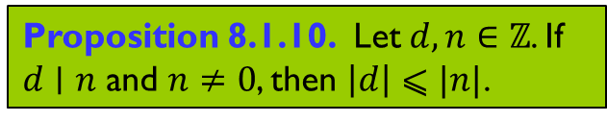
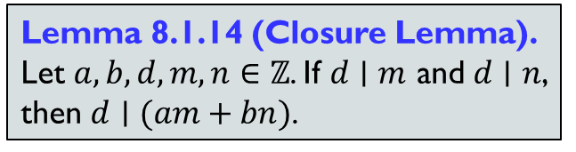
Q3. Let $a,b,s,t∈ℤ$ such that $as+bt=1.$ Show that $\gcd\left(a,b\right)=1.$
1. Let $d∈ℤ$ such that $d∣a$ and $d∣b$.
4. So $d⩽1$.
5. As $1$ is a common divisor of $a$ and $b$, it must be the greatest.
Lemma 8.1.14 (Closure Lemma).
Let $a,b,d,m,n∈ℤ$. If $d∣m$ and $d∣n$, then $d∣(am+bn)$.
Proposition 8.1.10. Let $d,n∈ℤ$. If $d∣n$ and $n≠0$, then $\left|d\right|⩽|n|$.

Slide 8
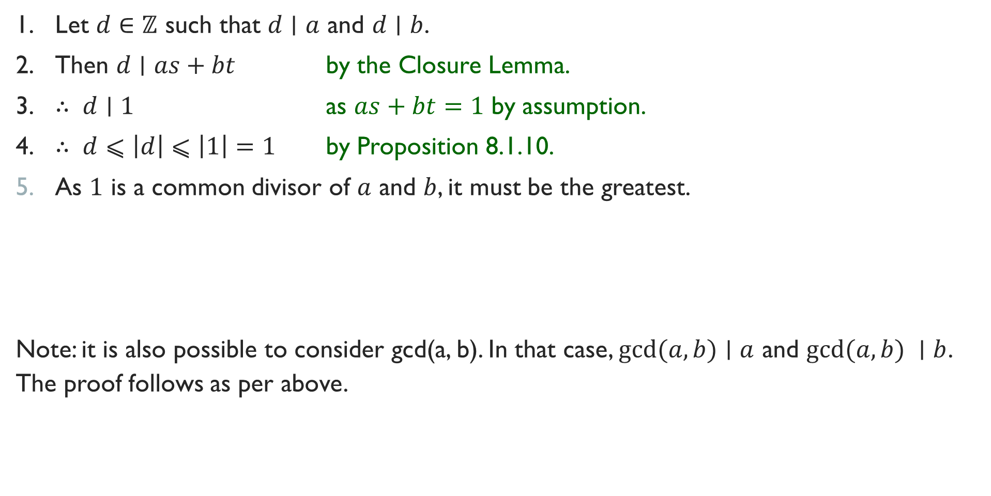
Q3. Let $a,b,s,t∈ℤ$ such that $as+bt=1.$ Show that $\gcd\left(a,b\right)=1.$
1. Let $d∈ℤ$ such that $d∣a$ and $d∣b$.
2. Then $d∣as+bt$ by the Closure Lemma.
3. $∴ d∣1$ as $as+bt=1$ by assumption.
4. $∴ d⩽\left|d\right|⩽\left|1\right|=1$ by Proposition 8.1.10.
As $1$ is a common divisor of $a$ and $b$, it must be the greatest.
Note: it is also possible to consider gcd(a, b). In that case, $gcd(a, b)∣a$ and $gcd(a, b) ∣b$. The proof follows as per above.
Lemma 8.1.14 (Closure Lemma).
Let $a,b,d,m,n∈ℤ$. If $d∣m$ and $d∣n$, then $d∣(am+bn)$.
Proposition 8.1.10. Let $d,n∈ℤ$. If $d∣n$ and $n≠0$, then $\left|d\right|⩽|n|$.

Slide 9

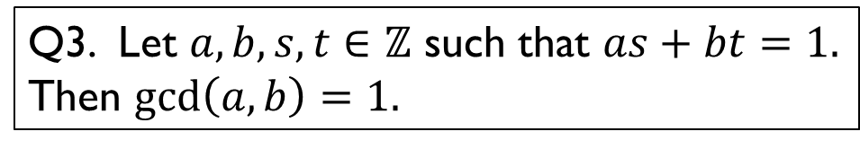
Q4. Let $a,b,s,t∈ℤ$ such that $as+bt=gcd(a, b).$ Show that $\gcd\left(s,t\right)=1$.
1. Let $a,b,s,t∈ℤ$ such that $as+bt=gcd(a,b)$.
4. So $ks+ℓt=1$ for some $k,ℓ∈ℤ$.
5. Hence $\gcd\left(s,t\right)=1$ by Q3.
Q3. Let $a,b,s,t∈ℤ$ such that $as+bt=1.$ Then $\gcd\left(a,b\right)=1.$

Slide 10
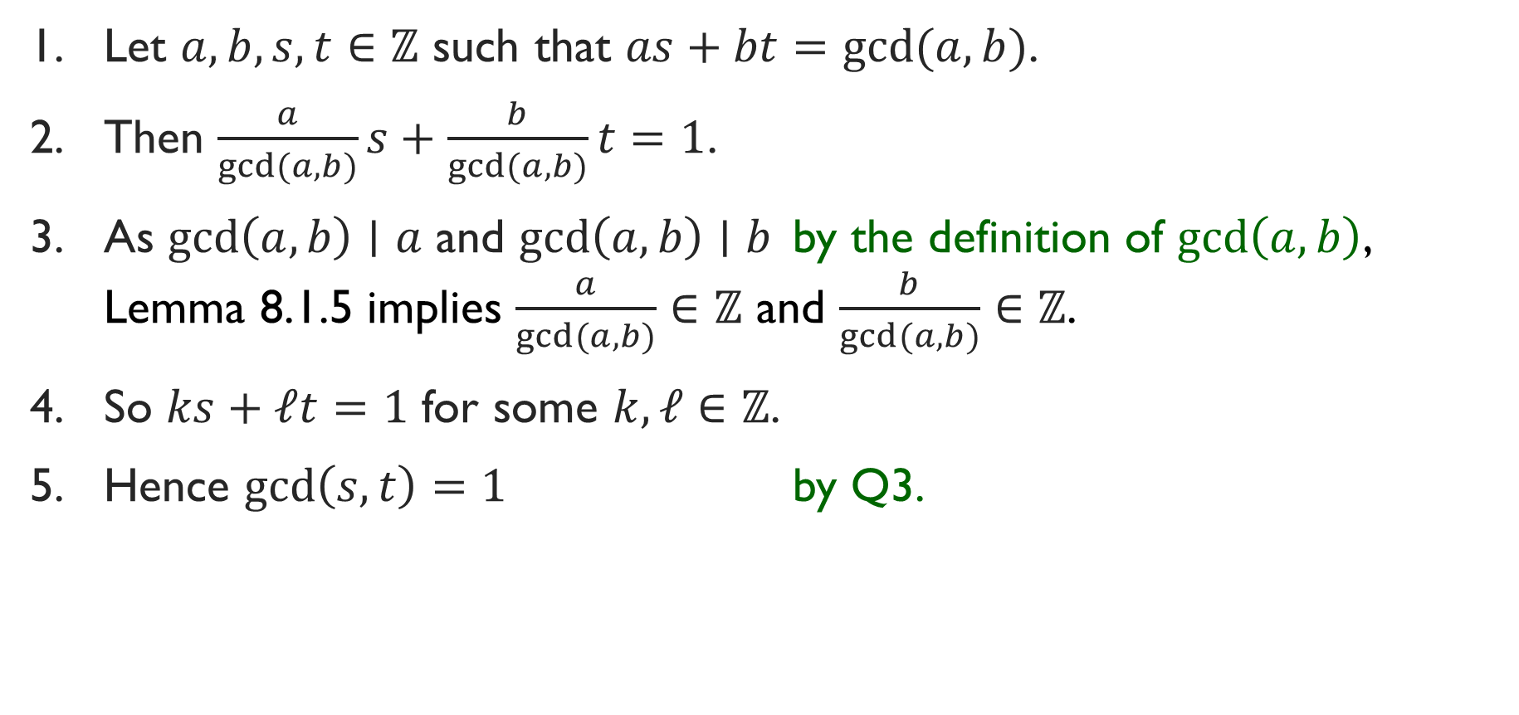
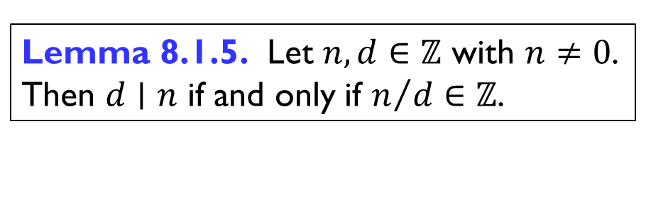
Q4. Let $a,b,s,t∈ℤ$ such that $as+bt=gcd(a, b).$ Show that $\gcd\left(s,t\right)=1$.
1. Let $a,b,s,t∈ℤ$ such that $as+bt=gcd(a,b)$.
2. Then $\frac{a}{gcd(a,b)}s+\frac{b}{gcd(a,b)}t=1$.
3. As $\gcd\left(a,b\right)∣a$ and $\gcd\left(a,b\right)∣b$ by the definition of $\gcd\left(a,b\right)$, Lemma 8.1.5 implies $\frac{a}{gcd(a,b)}∈ℤ$ and $\frac{b}{gcd(a,b)}∈ℤ$.
4. So $ks+ℓt=1$ for some $k,ℓ∈ℤ$.
5. Hence $\gcd\left(s,t\right)=1$ by Q3.
Lemma 8.1.5. Let $n,d∈ℤ$ with $n≠0$. Then $d∣n$ if and only if $n/d∈ℤ$.
Q3. Let $a,b,s,t∈ℤ$ such that $as+bt=1.$ Then $\gcd\left(a,b\right)=1.$

Slide 11
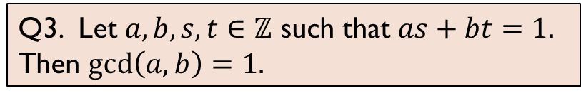

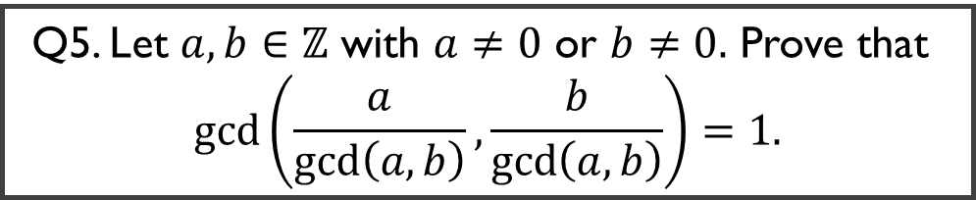
Q5. Let $a,b∈ℤ$ with $a≠0$ or $b≠0.$ Prove that $$\gcd\left(\frac{a}{\gcd\left(a,b\right)}, \frac{b}{\gcd\left(a,b\right)}\right)=1.$$
Q3. Let $a,b,s,t∈ℤ$ such that $as+bt=1.$ Then $\gcd\left(a,b\right)=1.$
1. Let $a,b∈ℤ$ with $a≠0$ or $b≠0$.
3. So $\frac{a}{\gcd\left(a,b\right)}s+\frac{b}{\gcd\left(a,b\right)}t=1$ for some $s,t∈ℤ$.
4. Hence $\gcd\left(\frac{a}{\gcd\left(a,b\right)}, \frac{b}{\gcd\left(a,b\right)}\right)=1$ by Q3.

Slide 12
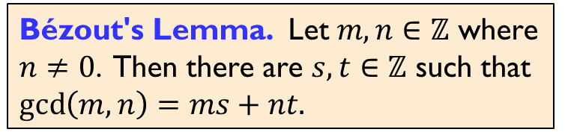

Q5. Let $a,b∈ℤ$ with $a≠0$ or $b≠0.$ Prove that $$\gcd\left(\frac{a}{\gcd\left(a,b\right)}, \frac{b}{\gcd\left(a,b\right)}\right)=1.$$
Q3. Let $a,b,s,t∈ℤ$ such that $as+bt=1.$ Then $\gcd\left(a,b\right)=1.$
Bézout's Lemma. Let $m,n∈ℤ$ where $n≠0$. Then there are $s,t∈ℤ$ such that $\gcd\left(m,n\right)=ms+nt.$
1. Let $a,b∈ℤ$ with $a≠0$ or $b≠0$.
2. We know $as+bt=gcd(a,b)$ for some $s,t∈ℤ$ by Bézout’s Lemma.
3. So $\frac{a}{\gcd\left(a,b\right)}s+\frac{b}{\gcd\left(a,b\right)}t=1$ for some $s,t∈ℤ$.
4. Hence $\gcd\left(\frac{a}{\gcd\left(a,b\right)}, \frac{b}{\gcd\left(a,b\right)}\right)=1$ by Q3.

Slide 13
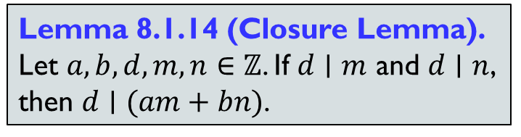


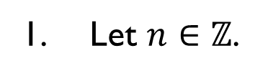
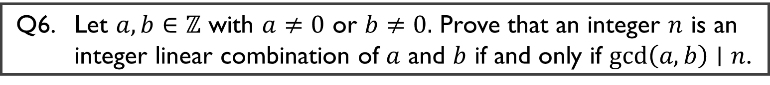

Q6. Let $a,b∈ℤ$ with $a≠0$ or $b≠0.$ Prove that an integer $n$ is an integer linear combination of $a$ and $b$ if and only if $\gcd\left(a,b\right)∣n$.
1. Let $n∈ℤ$.
Bézout's Lemma. Let $m,n∈ℤ$ where $n≠0$. Then there are $s,t∈ℤ$ such that $\gcd\left(m,n\right)=ms+nt.$
2. (“Only if”)
2.1. Let $s,t∈ℤ$ such that $n=as+bt$.
2.4. This means $\gcd\left(a,b\right)∣n.$
3. (“If”)
3.1. Suppose $\gcd\left(a,b\right)∣n$.
3.2. Use Bézout’s Lemma to find $k,ℓ∈ℤ$ such that $\gcd{(a,b)}=ak+bℓ$.
3.6. Hence $n=as+bt$ for some $s,t∈ℤ$.
Lemma 8.1.14 (Closure Lemma).
Let $a,b,d,m,n∈ℤ$. If $d∣m$ and $d∣n$, then $d∣(am+bn)$.

Slide 14
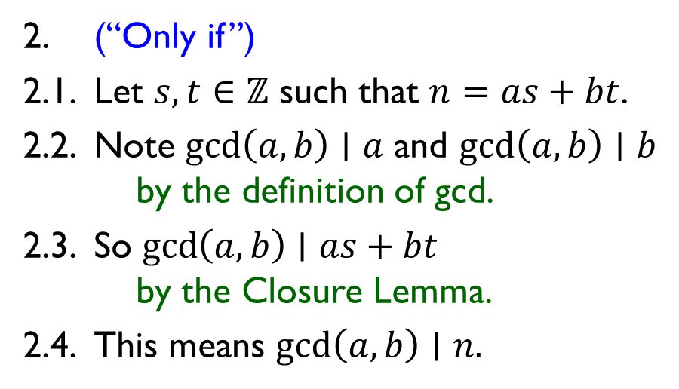
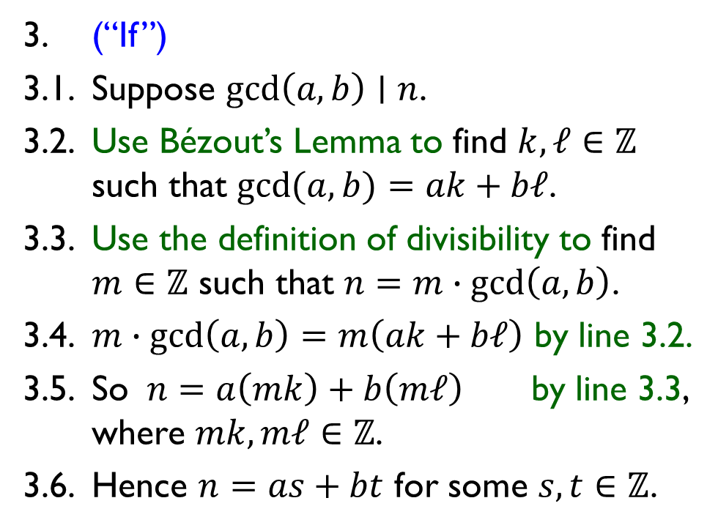
Q6. Let $a,b∈ℤ$ with $a≠0$ or $b≠0.$ Prove that an integer $n$ is an integer linear combination of $a$ and $b$ if and only if $\gcd\left(a,b\right)∣n$.
1. Let $n∈ℤ$.
Bézout's Lemma. Let $m,n∈ℤ$ where $n≠0$. Then there are $s,t∈ℤ$ such that $\gcd\left(m,n\right)=ms+nt.$
2. (“Only if”)
2.1. Let $s,t∈ℤ$ such that $n=as+bt$.
2.2. Note $\gcd\left(a,b\right)∣a$ and $\gcd\left(a,b\right)∣b$ by the definition of gcd.
2.3. So $\gcd\left(a,b\right)∣as+bt$ by the Closure Lemma.
2.4. This means $\gcd\left(a,b\right)∣n.$
3. (“If”)
3.1. Suppose $\gcd\left(a,b\right)∣n$.
3.2. Use Bézout’s Lemma to find $k,ℓ∈ℤ$ such that $\gcd{(a,b)}=ak+bℓ$.
3.3. Use the definition of divisibility to find $m∈ℤ$ such that $n=m∙gcd\left(a,b\right)$.
3.4. $m∙gcd\left(a,b\right)=m\left(ak+bℓ\right)$ by line 3.2.
3.5. So $n=a\left(mk\right)+b\left(mℓ\right)$ by line 3.3, where $mk,mℓ∈ℤ$.
3.6. Hence $n=as+bt$ for some $s,t∈ℤ$.
Lemma 8.1.14 (Closure Lemma).
Let $a,b,d,m,n∈ℤ$. If $d∣m$ and $d∣n$, then $d∣(am+bn)$.

Slide 15
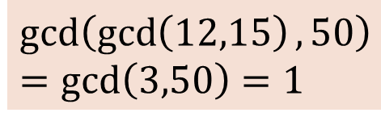

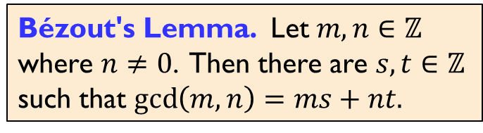
Q7. Find $x,y,z∈ℤ$ such that $12x−15y+50z=1.$
Bézout's Lemma. Let $m,n∈ℤ$ where $n≠0$. Then there are $s,t∈ℤ$ such that $\gcd\left(m,n\right)=ms+nt.$
$$gcd⁡(12,15)=3$$
$⇒$ $3$ is an integer linear combination of $12$ and $15$.
$$\gcd\left(\gcd\left(12,15\right),50\right)$$
$$=\gcd\left(3,50\right)=1$$
$⇒$ $1$ is an integer linear combination of $3$ and $50$.

Slide 16

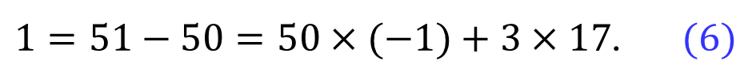

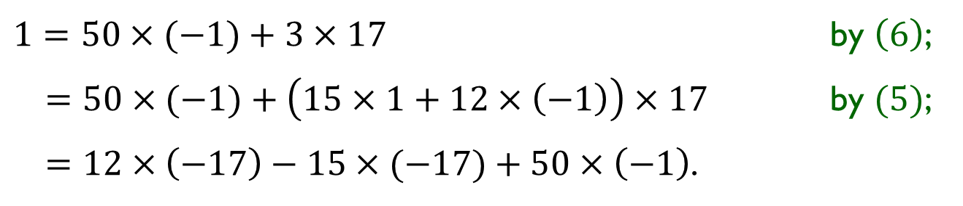

Q7. Find $x,y,z∈ℤ$ such that $12x−15y+50z=1.$
Bézout's Lemma. Let $m,n∈ℤ$ where $n≠0$. Then there are $s,t∈ℤ$ such that $\gcd\left(m,n\right)=ms+nt.$
$$gcd⁡(12,15)=3$$
$3=15−12=15×1+12×\left(−1\right).$ $(5)$
$⇒$ $3$ is an integer linear combination of $12$ and $15$.
$$\gcd\left(\gcd\left(12,15\right),50\right)$$
$$=\gcd\left(3,50\right)=1$$
$1=51−50=50×(−1)+3×17$. $(6)$
$⇒$ $1$ is an integer linear combination of $3$ and $50$.
$1=50×(−1)+3×17$ by $\left(6\right)$;
$=50×(−1)+\left(15×1+12×\left(−1\right)\right)×17$ by $(5)$;
$=12×\left(−17\right)−15×(−17)+50×\left(−1\right)$.
$$x$$
$$y$$
$$z$$

Slide 17
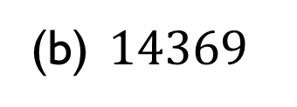
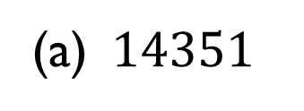
Q8. Determine the prime factorization of each of the following integers:
(a) $14351$
(b) $14369$

Slide 18

Q8. Determine the prime factorization of each of the following integers:
(a) $14351$
$$=113×127$$
(b) $14369$
It’s a prime!

Slide 19
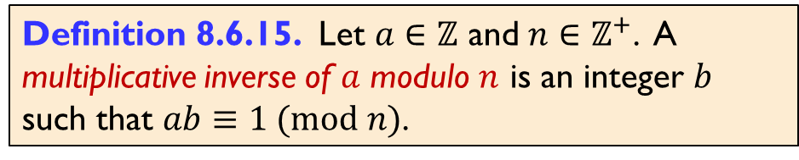
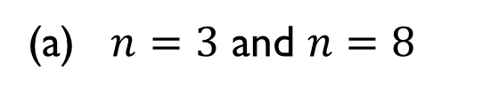
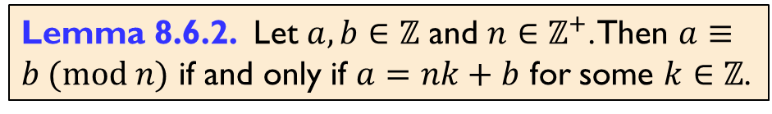
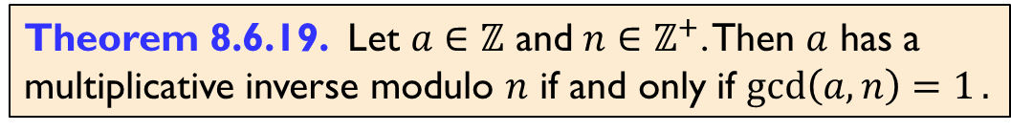
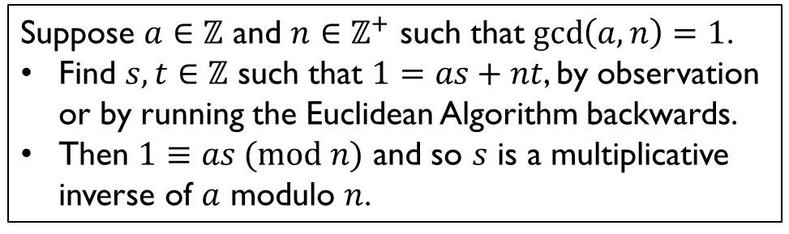
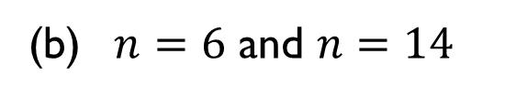
Q9. For each of the following pairs of $a$ and $n$, determine whether $a$ has a multiplicative inverse modulo $n$, and find one if it has any:
(a) $n=3$ and $n=8$
(b) $n=6$ and $n=14$
Lemma 8.6.2. Let $a,b∈ℤ$ and $n∈ℤ^{+}$. Then $a≡b (mod n)$ if and only if $a=nk+b$ for some $k∈ℤ$.
Suppose $a∈ℤ$ and $n∈ℤ^{+}$ such that $\gcd\left(a,n\right)=1$.
Find $s,t∈ℤ$ such that $1=as+nt$, by observation or by running the Euclidean Algorithm backwards.
Then $1≡as (mod n)$ and so $s$ is a multiplicative inverse of $a$ modulo $n$.
Definition 8.6.15. Let $a∈ℤ$ and $n∈ℤ^{+}$. A multiplicative inverse of $a$ modulo $n$ is an integer $b$ such that $ab≡1 (mod n)$.
Theorem 8.6.19. Let $a∈ℤ$ and $n∈ℤ^{+}$. Then $a$ has a multiplicative inverse modulo $n$ if and only if $\gcd\left(a,n\right)=1.$

Slide 20
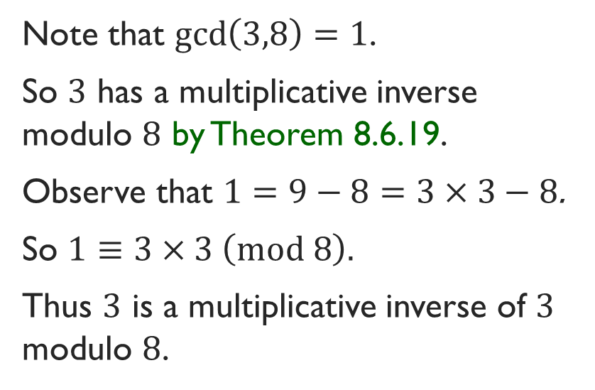
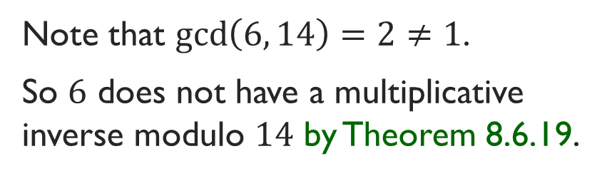
Q9. For each of the following pairs of $a$ and $n$, determine whether $a$ has a multiplicative inverse modulo $n$, and find one if it has any:
(a) $n=3$ and $n=8$
(b) $n=6$ and $n=14$
Note that $\gcd\left(3,8\right)=1$.
So $3$ has a multiplicative inverse modulo $8$ by Theorem 8.6.19.
Observe that $1=9−8=3×3−8$.
So $1≡3×3 \left(mod 8\right).$
Thus $3$ is a multiplicative inverse of $3$ modulo $8$.
Note that $\gcd\left(6, 14\right)=2≠1$.
So $6$ does not have a multiplicative inverse modulo $14$ by Theorem 8.6.19.
Lemma 8.6.2. Let $a,b∈ℤ$ and $n∈ℤ^{+}$. Then $a≡b (mod n)$ if and only if $a=nk+b$ for some $k∈ℤ$.
Suppose $a∈ℤ$ and $n∈ℤ^{+}$ such that $\gcd\left(a,n\right)=1$.
Find $s,t∈ℤ$ such that $1=as+nt$, by observation or by running the Euclidean Algorithm backwards.
Then $1≡as (mod n)$ and so $s$ is a multiplicative inverse of $a$ modulo $n$.
Definition 8.6.15. Let $a∈ℤ$ and $n∈ℤ^{+}$. A multiplicative inverse of $a$ modulo $n$ is an integer $b$ such that $ab≡1 (mod n)$.
Theorem 8.6.19. Let $a∈ℤ$ and $n∈ℤ^{+}$. Then $a$ has a multiplicative inverse modulo $n$ if and only if $\gcd\left(a,n\right)=1.$

Slide 21
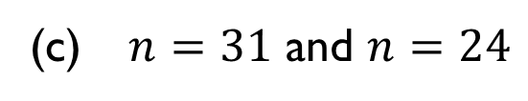
Q9. For each of the following pairs of $a$ and $n$, determine whether $a$ has a multiplicative inverse modulo $n$, and find one if it has any:
(c) $n=31$ and $n=24$
Suppose $a∈ℤ$ and $n∈ℤ^{+}$ such that $\gcd\left(a,n\right)=1$.
Find $s,t∈ℤ$ such that $1=as+nt$, by observation or by running the Euclidean Algorithm backwards.
Then $1≡as (mod n)$ and so $s$ is a multiplicative inverse of $a$ modulo $n$.
Definition 8.6.15. Let $a∈ℤ$ and $n∈ℤ^{+}$. A multiplicative inverse of $a$ modulo $n$ is an integer $b$ such that $ab≡1 (mod n)$.
Theorem 8.6.19. Let $a∈ℤ$ and $n∈ℤ^{+}$. Then $a$ has a multiplicative inverse modulo $n$ if and only if $\gcd\left(a,n\right)=1.$

Slide 22
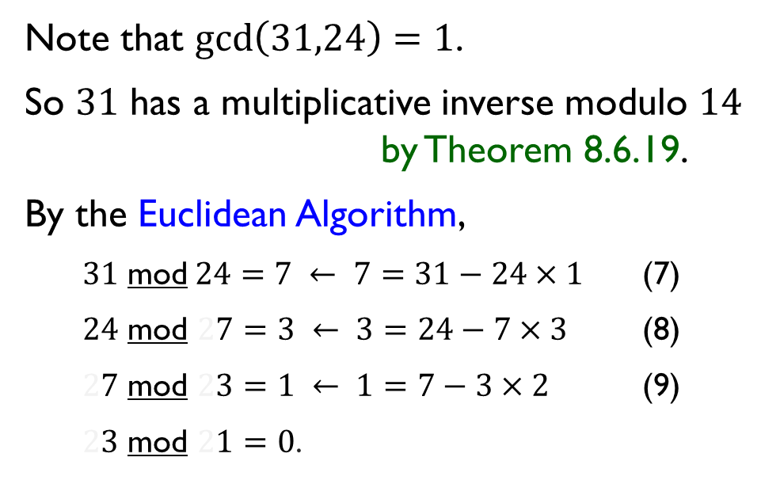
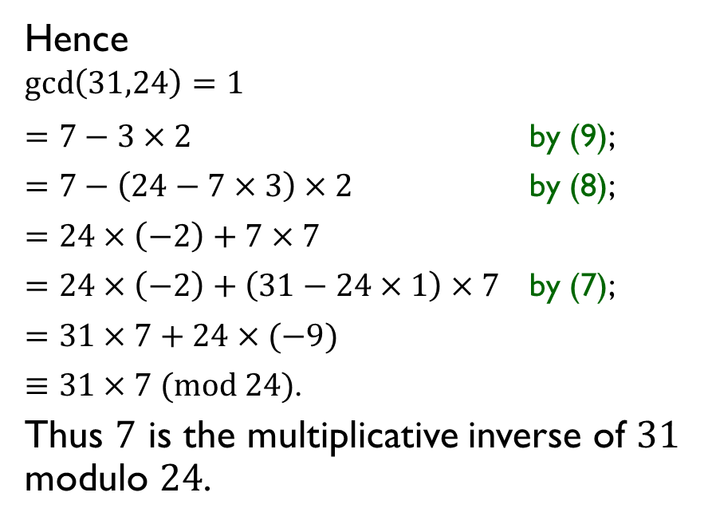
Q9. For each of the following pairs of $a$ and $n$, determine whether $a$ has a multiplicative inverse modulo $n$, and find one if it has any:
(c) $n=31$ and $n=24$
Hence
$$\gcd\left(31,24\right)=1$$
$=7−3×2$ by (9);
$=7−\left(24−7×3\right)×2$ by (8);
$=24×\left(−2\right)+7×7$
$=24×\left(−2\right)+\left(31−24×1\right)×7$ by (7);
$=31×7+24×(−9)$
$≡31×7 (mod 24)$.
Thus $7$ is the multiplicative inverse of $31$ modulo $24$.
Note that $\gcd\left(31,24\right)=1$.
So $31$ has a multiplicative inverse modulo $14$ by Theorem 8.6.19.
By the Euclidean Algorithm,
$31$ mod$24=7 ← 7=31−24×1$ (7)
$24$ mod $27=3 ← 3=24−7×3$ (8)
$27$ mod $23=1 ← 1=7−3×2$ (9)
$23$ mod $21=0$.
Suppose $a∈ℤ$ and $n∈ℤ^{+}$ such that $\gcd\left(a,n\right)=1$.
Find $s,t∈ℤ$ such that $1=as+nt$, by observation or by running the Euclidean Algorithm backwards.
Then $1≡as (mod n)$ and so $s$ is a multiplicative inverse of $a$ modulo $n$.
Definition 8.6.15. Let $a∈ℤ$ and $n∈ℤ^{+}$. A multiplicative inverse of $a$ modulo $n$ is an integer $b$ such that $ab≡1 (mod n)$.
Theorem 8.6.19. Let $a∈ℤ$ and $n∈ℤ^{+}$. Then $a$ has a multiplicative inverse modulo $n$ if and only if $\gcd\left(a,n\right)=1.$

Slide 23

Q10(a). Find all integers $x$, if any, that satisfy $5x≡2 \left(mod 32\right)$.
Suppose $a∈ℤ$ and $n∈ℤ^{+}$ such that $\gcd\left(a,n\right)=1$.
Find $s,t∈ℤ$ such that $1=as+nt$, by observation or by running the Euclidean Algorithm backwards.
Then $1≡as (mod n)$ and so $s$ is a multiplicative inverse of $a$ modulo $n$.
To solve $ax≡c (mod n)$, where $gcd\left(a,n\right)=1$.
Find a multiplicative inverse $b$ of $a$ modulo $n$.
The solution is $x≡bc (mod n)$.
Theorem 8.6.19. Let $a∈ℤ$ and $n∈ℤ^{+}$. Then $a$ has a multiplicative inverse modulo $n$ if and only if $\gcd\left(a,n\right)=1.$

Slide 24

Q10(a). Find all integers $x$, if any, that satisfy $5x≡2 \left(mod 32\right)$.
$\gcd\left(5, 32\right)=1$.
So $5$ has a multiplicative inverse modulo $32$.
$1=65−64=5×13+32×\left(−2\right)$
$≡5×13 \left(mod 32\right)$.
So $13$ is a multiplicative inverse of $5$ modulo $32$.
The solution is $x≡13×2=26 \left(mod 32\right)$.
Suppose $a∈ℤ$ and $n∈ℤ^{+}$ such that $\gcd\left(a,n\right)=1$.
Find $s,t∈ℤ$ such that $1=as+nt$, by observation or by running the Euclidean Algorithm backwards.
Then $1≡as (mod n)$ and so $s$ is a multiplicative inverse of $a$ modulo $n$.
To solve $ax≡c (mod n)$, where $gcd\left(a,n\right)=1$.
Find a multiplicative inverse $b$ of $a$ modulo $n$.
The solution is $x≡bc (mod n)$.
Theorem 8.6.19. Let $a∈ℤ$ and $n∈ℤ^{+}$. Then $a$ has a multiplicative inverse modulo $n$ if and only if $\gcd\left(a,n\right)=1.$

Slide 25




Q10(b). Find all integers $x$, if any, that satisfy $4x≡6 \left(mod 48\right)$.
$\gcd\left(4, 48\right)=4≠1$.
So $4$ does not have a multiplicative inverse modulo $48.$
Lemma 8.6.2. Let $a,b∈ℤ$ and $n∈ℤ^{+}$. Then $a≡b (mod n)$ if and only if $a=nk+b$ for some $k∈ℤ$.
To solve $ax≡c (mod n)$, where $gcd\left(a,n\right)=1$.
Find a multiplicative inverse $b$ of $a$ modulo $n$.
The solution is $x≡bc (mod n)$.
Q6. Let $a,b∈ℤ$ with $a≠0 or b≠0.$ An integer $n$ is an integer linear combination of $a$ and $b$ if and only if $\gcd\left(a,b\right)∣n$.
Theorem 8.6.19. Let $a∈ℤ$ and $n∈ℤ^{+}$. Then $a$ has a multiplicative inverse modulo $n$ if and only if $\gcd\left(a,n\right)=1.$

Slide 26


Q10(b). Find all integers $x$, if any, that satisfy $4x≡6 \left(mod 48\right)$.
$\gcd\left(4, 48\right)=4≠1$.
So $4$ does not have a multiplicative inverse modulo $48.$
We prove that $4x≡6 \left(mod 48\right)$ has no solution by contradiction.
1. Suppose $x∈ℤ$ such that $4x≡6 \left(mod 48\right)$.
2. Use Lemma 8.6.2 to get $k∈ℤ$ such that $4x=48k+6.$
3. Note that $6$ is an integer linear combination of $4$ and $48$ as $6=4x+48(−k)$.
So $\gcd\left(4,48\right)∣6$ by Q6.
5. However, we know $\gcd\left(4,48\right)=4$ and $4∤6$ by Lemma 8.1.5 as $6/4∉ℤ$, which is the required contradiction.
Lemma 8.6.2. Let $a,b∈ℤ$ and $n∈ℤ^{+}$. Then $a≡b (mod n)$ if and only if $a=nk+b$ for some $k∈ℤ$.
Lemma 8.1.5. Let $n,d∈ℤ$ with $n≠0$. Then $d∣n$ if and only if $n/d∈ℤ$.
To solve $ax≡c (mod n)$, where $gcd\left(a,n\right)=1$.
Find a multiplicative inverse $b$ of $a$ modulo $n$.
The solution is $x≡bc (mod n)$.
Q6. Let $a,b∈ℤ$ with $a≠0 or b≠0.$ An integer $n$ is an integer linear combination of $a$ and $b$ if and only if $\gcd\left(a,b\right)∣n$.
Theorem 8.6.19. Let $a∈ℤ$ and $n∈ℤ^{+}$. Then $a$ has a multiplicative inverse modulo $n$ if and only if $\gcd\left(a,n\right)=1.$

Slide 27




Q11(a). Let $a,b∈ℤ$ and $m,n∈ℤ^{+}$ with $\gcd\left(m,n\right)=1$. Consider the following system of simultaneous congruence equations: $$\left\{\begin{aligned} x≡a \left(mod m\right); \\ x≡b \left(mod n\right).\end{aligned}\right.$$ Apply Bézout’s Lemma to ﬁnd $s,t∈ℤ$ such that $ms+nt=1$. Let $c_{0}=ant+bms.$ Verify that $x=c_{0}$ is a solution to the system of simultaneous congruence equations above.
We want to show $c_{0}≡a (mod m)$ and $c_{0}≡b \left(mod m\right).$
$c_{0}=ant+bms$ by the definition of $c_{0}$;
$≡a (mod m)$.
$c_{0}=ant+bms$ by the definition of $c_{0}$;
$≡b (mod n)$.
Lemma 8.6.2. Let $a,b∈ℤ$ and $n∈ℤ^{+}$. Then $a≡b (mod n)$ if and only if $a=nk+b$ for some $k∈ℤ$.

Slide 28


Q11(a). Let $a,b∈ℤ$ and $m,n∈ℤ^{+}$ with $\gcd\left(m,n\right)=1$. Consider the following system of simultaneous congruence equations: $$\left\{\begin{aligned} x≡a \left(mod m\right); \\ x≡b \left(mod n\right).\end{aligned}\right.$$ Apply Bézout’s Lemma to ﬁnd $s,t∈ℤ$ such that $ms+nt=1$. Let $c_{0}=ant+bms.$ Verify that $x=c_{0}$ is a solution to the system of simultaneous congruence equations above.
We want to show $c_{0}≡a (mod m)$ and $c_{0}≡b \left(mod m\right).$
$c_{0}=ant+bms$ by the definition of $c_{0}$;
$=a\left(1−ms\right)+bms$ by the choice of $s$ and $t$;
$=a+m(−as+bs)$
$≡a (mod m)$ as $−as+bs∈ℤ$.
$c_{0}=ant+bms$ by the definition of $c_{0}$;
$=ant+b(1−nt)$ by the choice of $s$ and $t$;
$=b+n(at−bt)$
$≡b (mod n)$ as $at−bt∈ℤ$.
Lemma 8.6.2. Let $a,b∈ℤ$ and $n∈ℤ^{+}$. Then $a≡b (mod n)$ if and only if $a=nk+b$ for some $k∈ℤ$.

Slide 29





Q11(b). Let $a,b∈ℤ$ and $m,n∈ℤ^{+}$ with $\gcd\left(m,n\right)=1$. Consider the following system of congruence equations: $$\left\{\begin{aligned} x≡a \left(mod m\right); \\ x≡b \left(mod n\right).\end{aligned}\right.$$ Apply Bézout’s Lemma to ﬁnd $s,t∈ℤ$ such that $ms+nt=1$. Let $c_{0}=ant+bms.$ Let $c∈ℤ$. Prove that $x=c$ is a solution to the system of congruence equations above if and only if $c≡c_{0} \left(mod mn\right).$
1. (“Only if”)
1.1. Suppose $x=c$ is a solution to the system of congruence equations.
1.2. This means $c≡a (mod m)$ and $c≡b (mod n)$.
1.6 Hence $c≡c_{0} \left(mod mn\right)$.
2. (“If”)
2.1. Suppose $c≡c_{0} (mod mn)$.
2.3. Then $c=$
$≡a (mod m)$.
2.4. Similarly, $c=$
$≡b (mod n)$.
2.5. So $x=c$ is a solution to the system of congruence equations.
Q2. $∀a,b,c∈ℤ (a∣c∧b∣c∧\gcd\left(a,b\right)=1⇒ab∣c).$
Lemma 8.6.2. $a≡b (mod n)$ iff $n∣(a−b)$
iff $a=nk+b$ for some $k∈ℤ$.
Q11(a). $c_{0}≡a (mod m)$ and $c_{0}≡b (mod n)$.

Slide 30


Q11(b). Let $a,b∈ℤ$ and $m,n∈ℤ^{+}$ with $\gcd\left(m,n\right)=1$. Consider the following system of congruence equations: $$\left\{\begin{aligned} x≡a \left(mod m\right); \\ x≡b \left(mod n\right).\end{aligned}\right.$$ Apply Bézout’s Lemma to ﬁnd $s,t∈ℤ$ such that $ms+nt=1$. Let $c_{0}=ant+bms.$ Let $c∈ℤ$. Prove that $x=c$ is a solution to the system of congruence equations above if and only if $c≡c_{0} \left(mod mn\right).$
1. (“Only if”)
1.1. Suppose $x=c$ is a solution to the system of congruence equations.
1.2. This means $c≡a (mod m)$ and $c≡b (mod n)$.
1.3. So $c≡c_{0} (mod m)$ and $c≡c_{0} (mod n)$ by part (a).
1.4. $∴ m∣(c−c_{0})$ and $n∣\left(c−c_{0}\right)$ by Lemma 8.6.2.
1.5. Thus $mn∣(c−c_{0})$ by Q2 as $\gcd{(m,n)}=1$.
1.6 Hence $c≡c_{0} \left(mod mn\right)$ by Lemma 8.6.2.
2. (“If”)
2.1. Suppose $c≡c_{0} (mod mn)$.
2.2. Use Lemma 8.6.2 to find $k∈ℤ$ such that $c=k\left(mn\right)+c_{0}$.
2.3. Then $c=c_{0}+m\left(kn\right)$
$≡c_{0} \left(mod m\right)$
$≡a (mod m)$ by part (a).
2.4. Similarly, $c=c_{0}+n\left(km\right)$
$≡c_{0} \left(mod n\right)$
$≡b (mod n)$ by part (a).
2.5. So $x=c$ is a solution to the system of congruence equations.
Q2. $∀a,b,c∈ℤ (a∣c∧b∣c∧\gcd\left(a,b\right)=1⇒ab∣c).$
Lemma 8.6.2. $a≡b (mod n)$ iff $n∣(a−b)$
iff $a=nk+b$ for some $k∈ℤ$.
Q11(a). $c_{0}≡a (mod m)$ and $c_{0}≡b (mod n)$.

